Slide 1
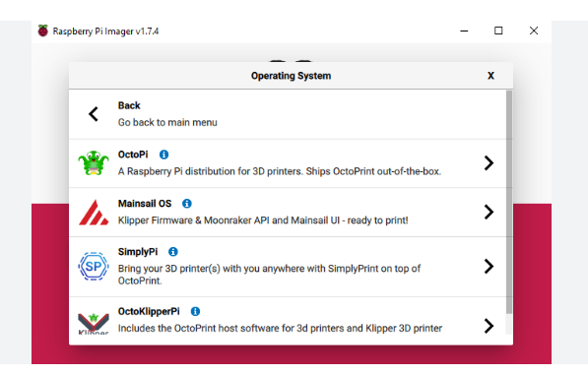
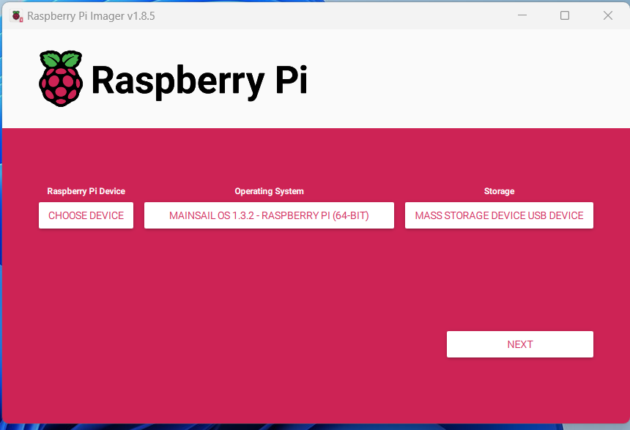
Installation of Mainsailos on Raspberry 3b+ with raspberry imager, SD card needed.
->Other spec OS Mainsail 64 bit
Set wifi and password etc, host name is critical!
Configuring Multiple 3D Printers on Mainsail? Raspberry Pi x2 and Mainsail x2

Slide 2
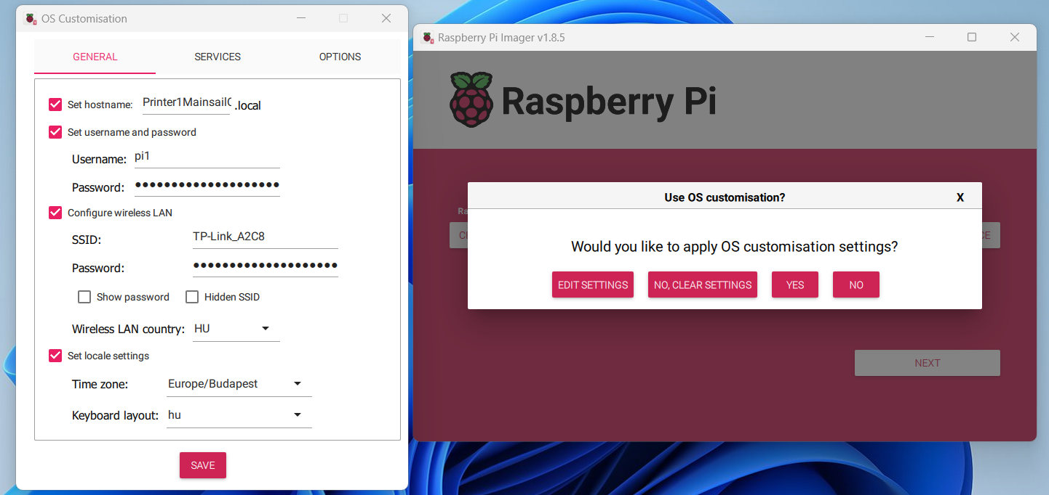
MainsailOS RP3b+ SKR2
Set wifi and password etc, host name critical!
Configuring Multiple 3D Printers on Mainsail? Raspberry Pi x2 and Mainsail x2

Slide 3
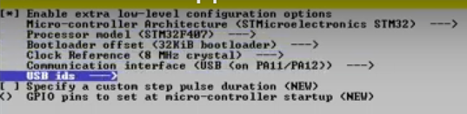
cd klipper
make menuconfig
Make -> klipper.bin

Slide 4
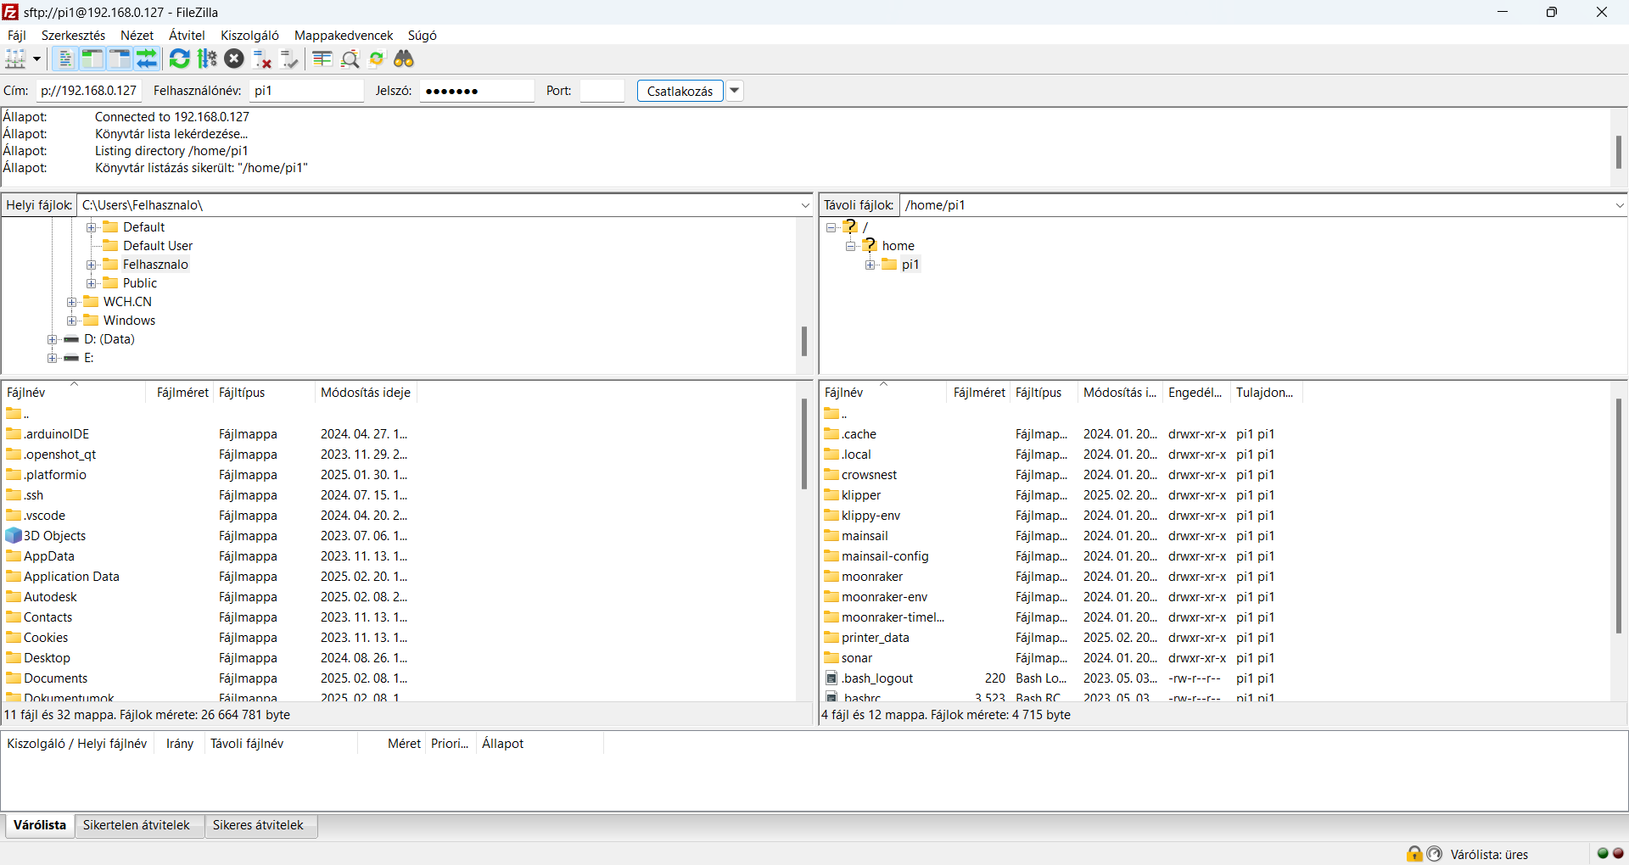
Download FileZilla and connect to Raspberry 3b+
Rename Klipper.bin to firmware.bin and copy to SD card ->power on SKR2
Get firmware.cur if OK

Slide 5
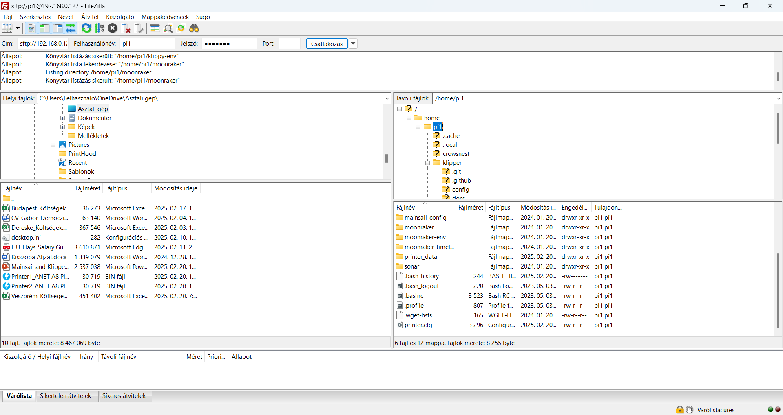
FileZilla - Copy printer.cfg and upload to Mainsail

Slide 6
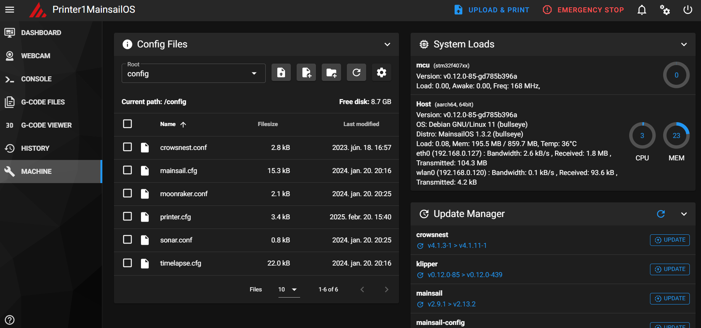
Copy printer.cfg and upload to Mainsail

Slide 7
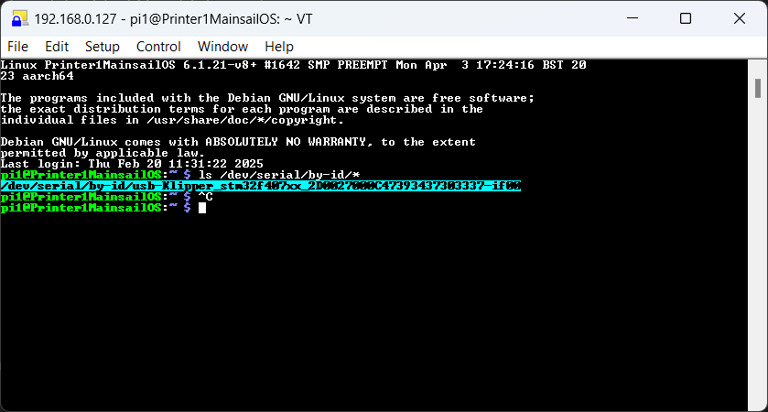
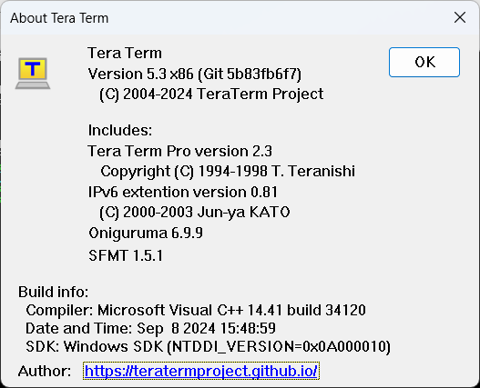
lD USB
Tera Term = host=192.168.0.127-> pi1 and password
Get USB ID: ls /dev/serial/by-id/*
Release Tera Term 5.3 · TeraTermProject/teraterm

Slide 8
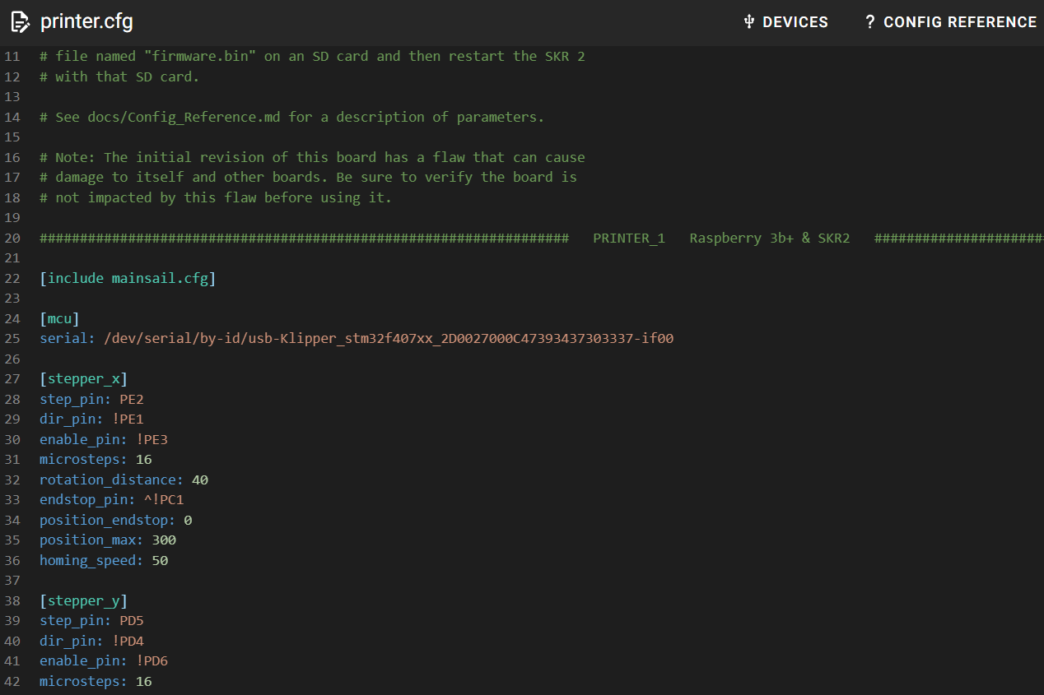
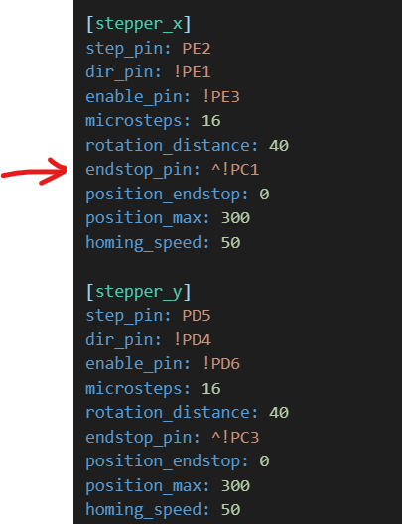
Copy usb address to printer.cfg

Slide 9
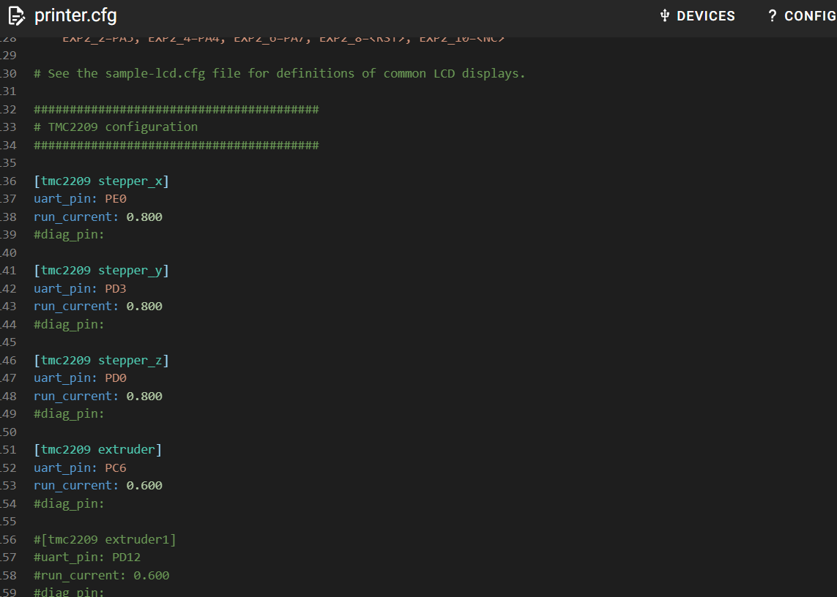
Enable TMC2209 in printer.cfg

Slide 10
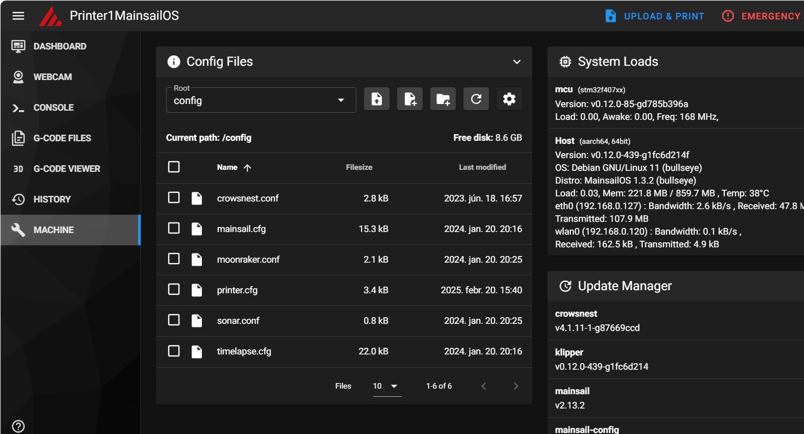

Slide 11
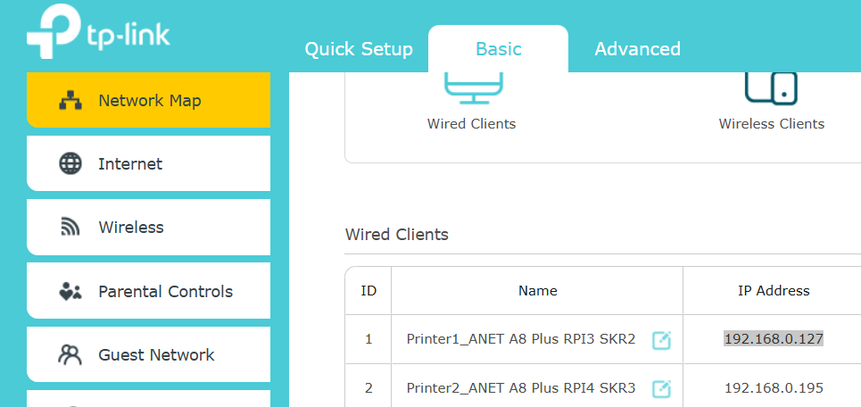

Slide 12
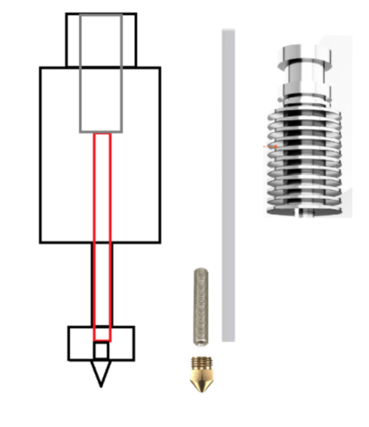
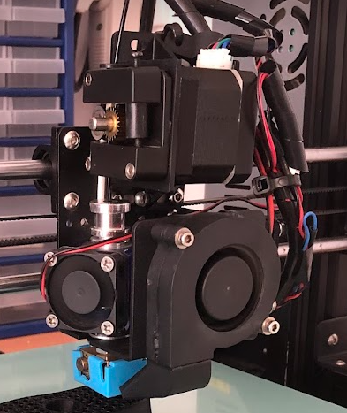

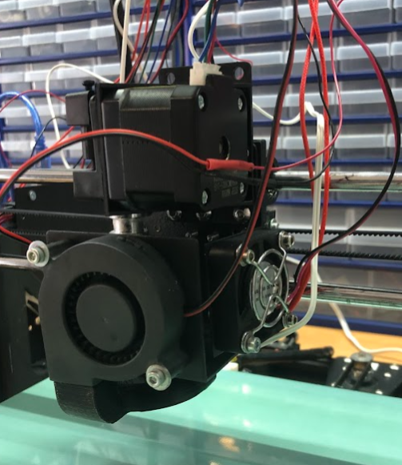
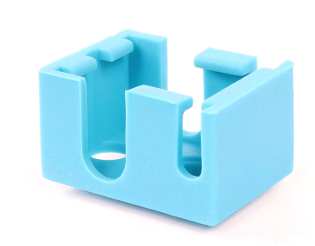
Volcano V6 Extruder Solution

